Slide 2
INCOMING TRANSMISSION
TO: CAPT. L. TOTH • EECT • 112-51C
FROM: ALCIDES SEGOVIA & KEN FISCHER
COMMAND AUTHORIZATION REQUIRED

Slide 3
Why We Picked This Project
Basic Stamp was the first experience with programming.
We picked this project basically because it looked very interesting.
Ken is a fulltime student taking 4 courses.
Al works full time, serves as a Sunday School Teacher for his church, and helps coach his son’s football team.

Slide 4
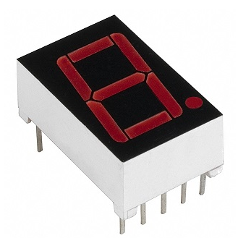
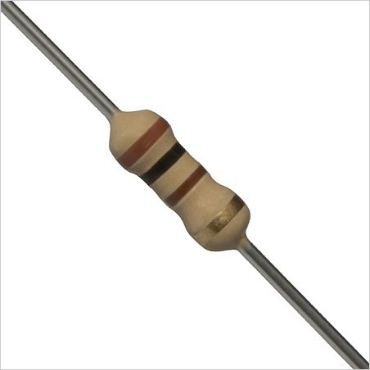
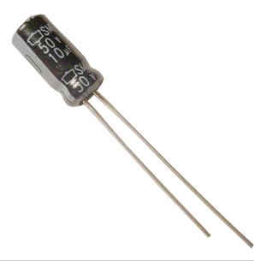
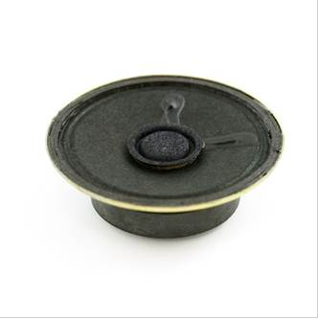
Equipment
MAN6780C series 7-segment LED display
Resistor 100Ω
Speaker
Capacitor 10μF
BASIC Stamp Manual
Internet

Slide 5


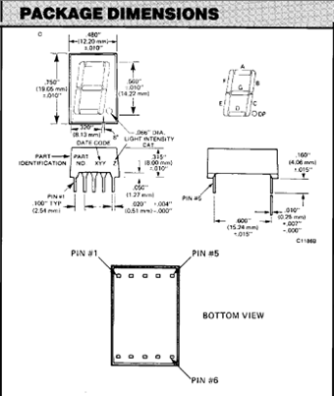
Research/Challenges
Research
  Looked up the data sheet for the 7-segment LED display
Challenges
  The pins were not going to the Anode that the data sheet said.
  We wrote a program to light up one segment at a time to figure out which pin went to which segment.
  Not all the outputs worked. (1 & 3)
  As we ran the program, if an output did not work we moved to the next one.

Slide 6
Research/Challenges
Research
  Looked up the commands and what they meant.
    CON – Constant Value
    OUTPUT – The output Pin
    HIGH/LOW
    VAR – declare the variable type (Bit, Nib, Byte or Word)
    FOR Cnt – Counter
Challenges
  Make the segments light up, going in a circle.
  We used the “FOR Cnt” command to make the cycle.
  Make it count from 0 to 9, then A to F, and back.
  Wrote the program in that sequence, using HIGH and LOW for each segment accordingly.

Slide 7
New Ideas
Challenges
  What else can we do?
  Add sound. Look-up the command for sound. (FREQOUT)
  Add something in between the count – a crisscross pattern.
  Put a backwards going in circle pattern before it starts counting backwards.

Slide 8
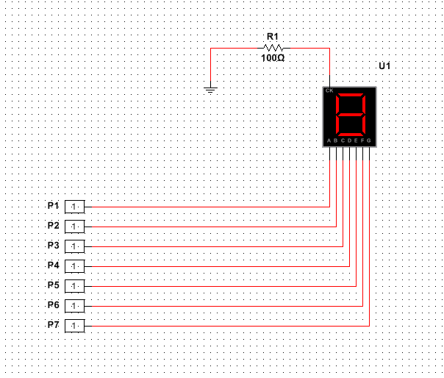
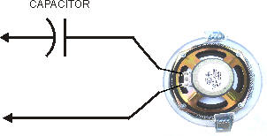
SCHEMATIC
 | Segments
 |  | a | b | c | d | e | f | g
Count | 0 | 1 | 1 | 1 | 1 | 1 | 1 | 0
 | 1 | 0 | 1 | 1 | 0 | 0 | 0 | 0
 | 2 | 1 | 1 | 0 | 1 | 1 | 0 | 1
 | 3 | 1 | 1 | 1 | 1 | 0 | 0 | 1
 | 4 | 0 | 1 | 1 | 0 | 0 | 1 | 1
 | 5 | 1 | 0 | 1 | 1 | 0 | 1 | 1
 | 6 | 1 | 0 | 1 | 1 | 1 | 1 | 1
 | 7 | 1 | 1 | 1 | 0 | 0 | 0 | 0
 | 8 | 1 | 1 | 1 | 1 | 1 | 1 | 1
 | 9 | 1 | 1 | 1 | 0 | 0 | 1 | 1
 | A | 1 | 1 | 1 | 0 | 1 | 1 | 1
 | b | 0 | 0 | 1 | 1 | 1 | 1 | 1
 | C | 1 | 0 | 0 | 1 | 1 | 1 | 0
 | d | 0 | 1 | 1 | 1 | 1 | 0 | 1
 | E | 1 | 0 | 0 | 1 | 1 | 1 | 1
 | F | 1 | 0 | 0 | 0 | 1 | 1 | 1

Slide 9
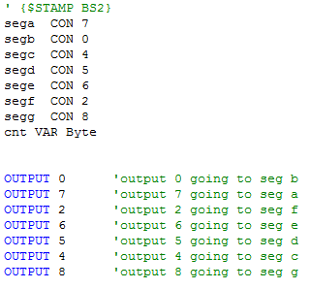
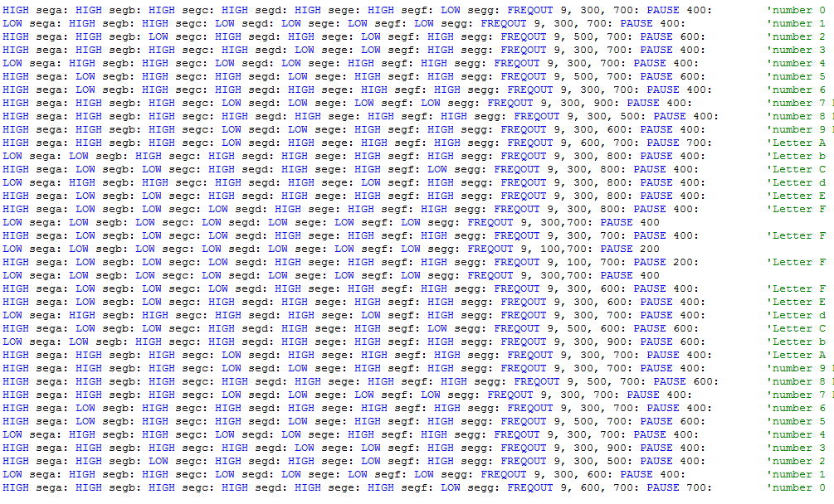
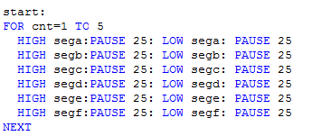
Software

Slide 10
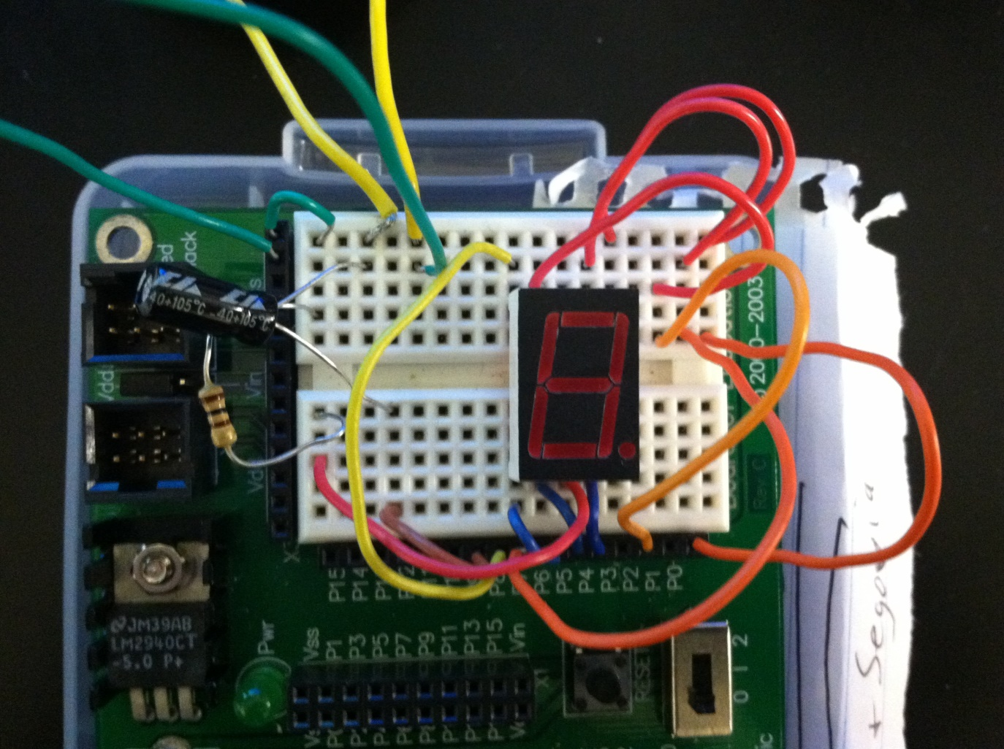
Wiring

Slide 11
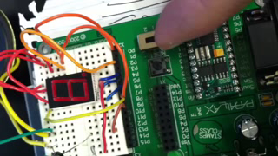
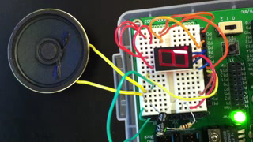
Videos

Slide 12
Conclusion
We enjoyed working through problems and some of the new commands.
As we progressed it even got more amazing and motivating.
Had fun putting our new ideas in and seeing them work.

Slide 13
ANY QUESTIONS?
THANK YOU

